Slide 1
Re-training the matterport mask-rcnn model to detect electric scooters
Chris birch { deep learning engineer }

Slide 2
Presentation outline
What the hell is matterport Mask-RCNN?
Neural Networks / Convolutions / Semantic Segmentation
Transfer Learning
What’s Going on Here?
Results
Transfer Learning
SkyNet is Watching You

Slide 3
What the hell is matterport mask-rcnn

Slide 4
matterport mask-rcnn

Slide 5
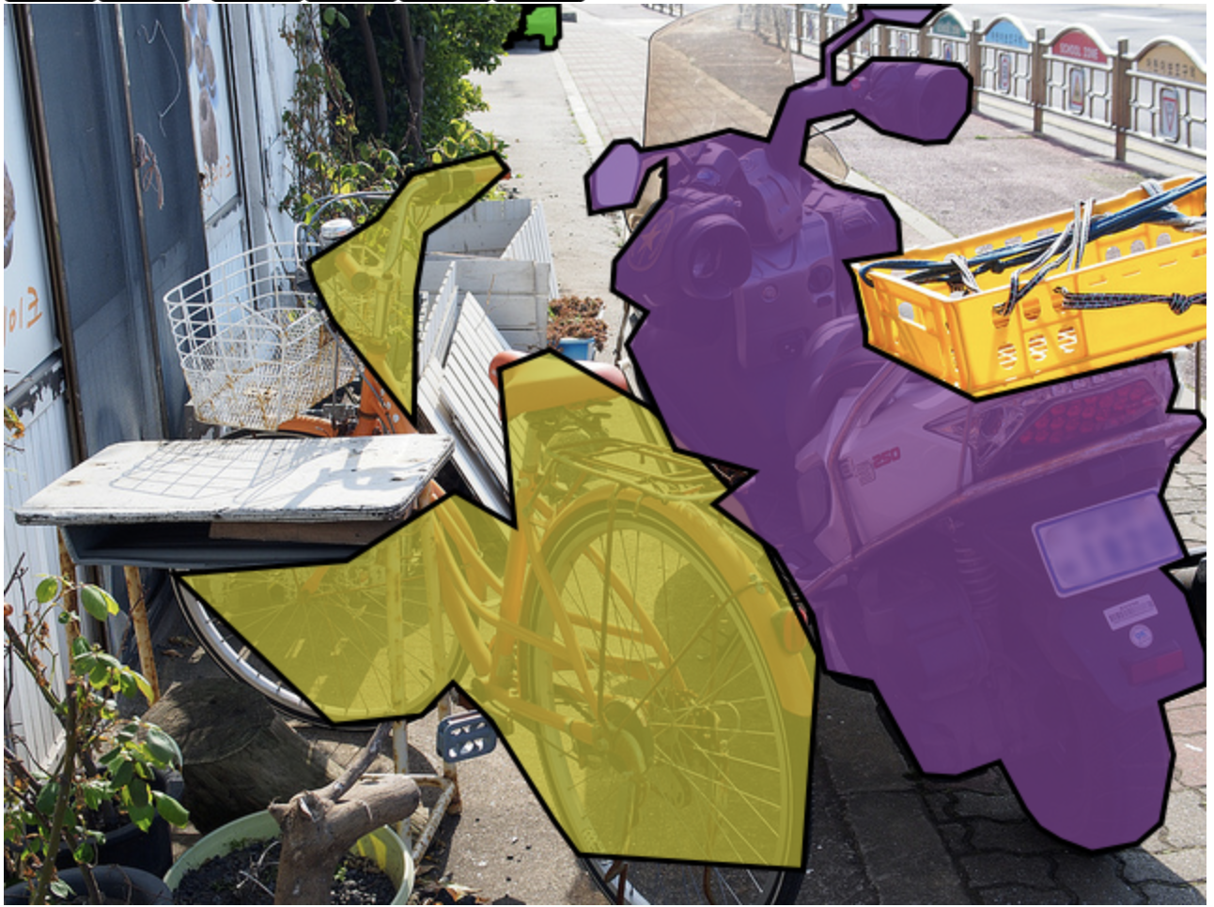
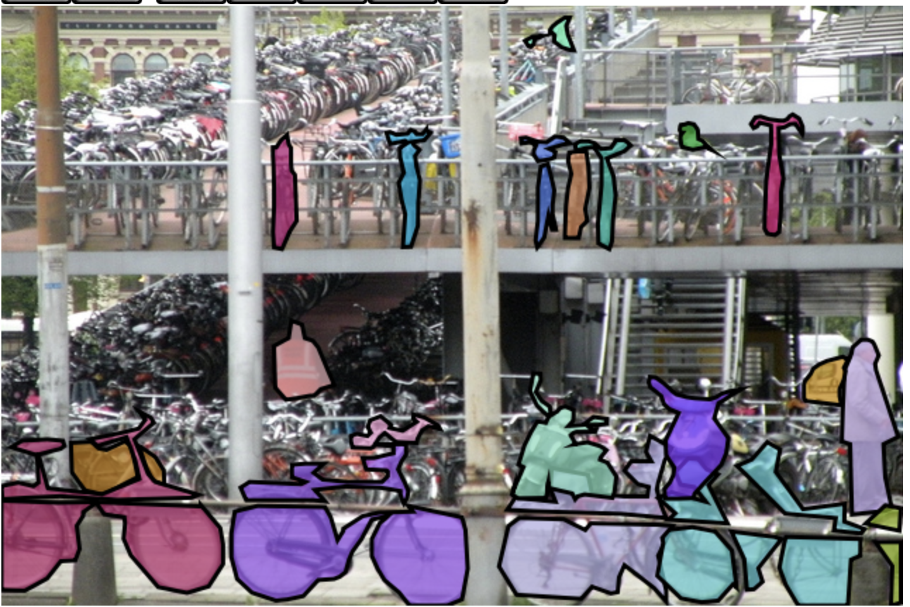
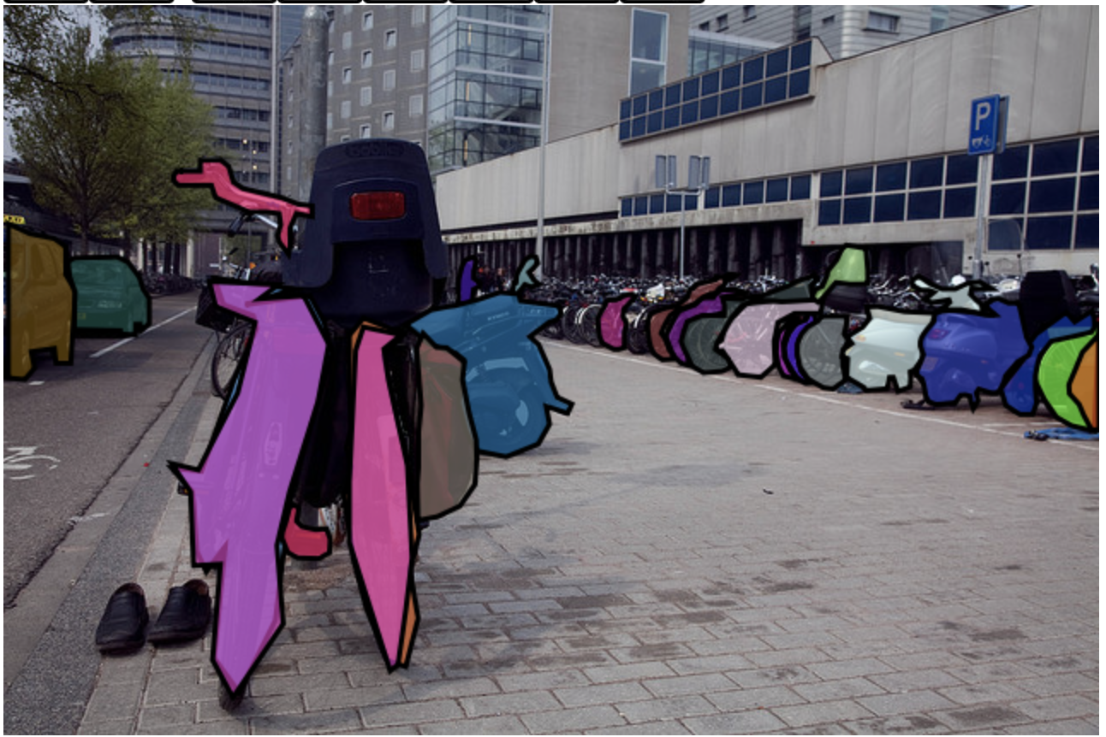
matterport mask-rcnn

Slide 6
Neural Networks convolutions semantic segmentation

Slide 7
Transfer learning

Slide 8
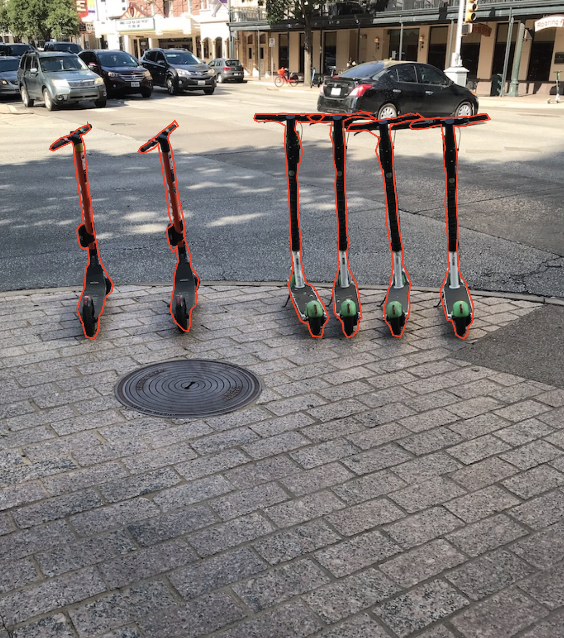
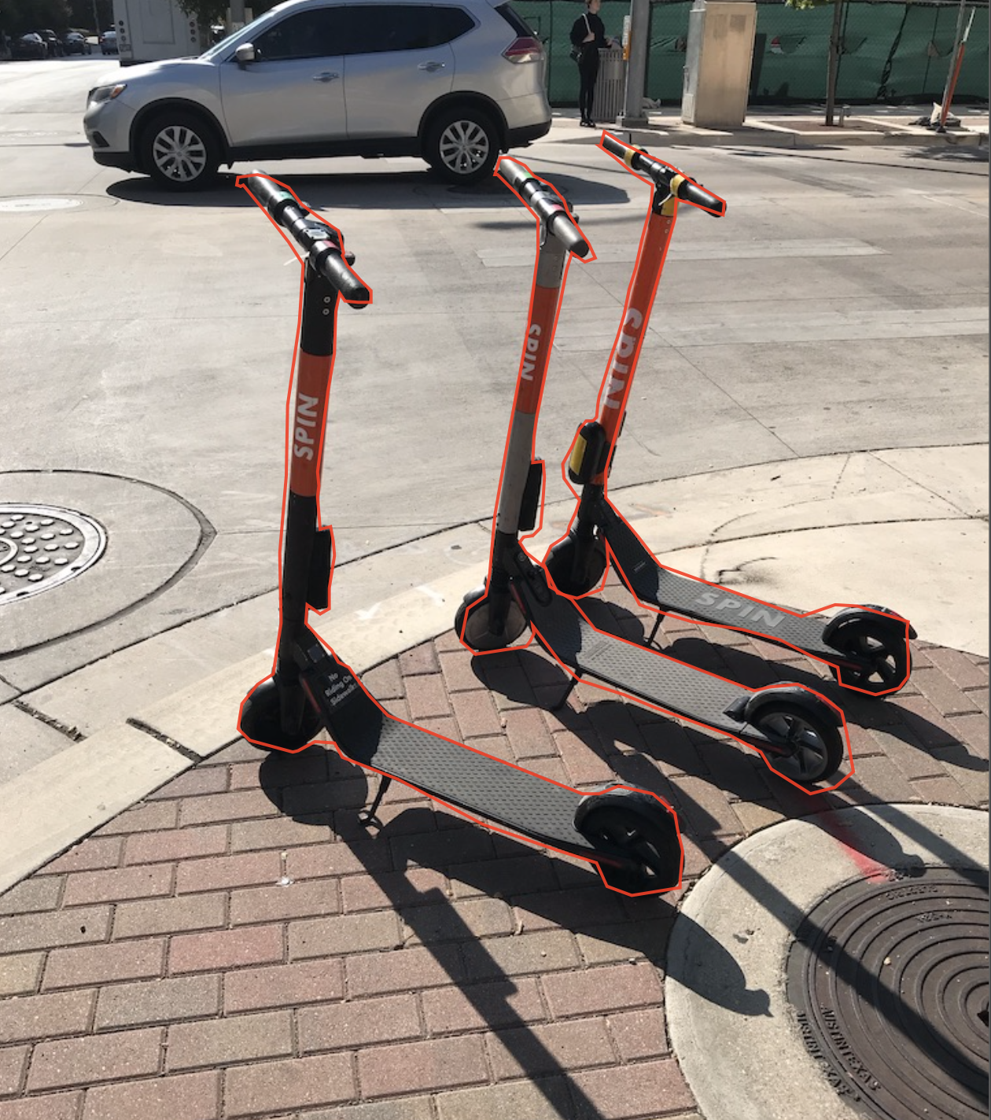
What’s going on here?

Slide 9
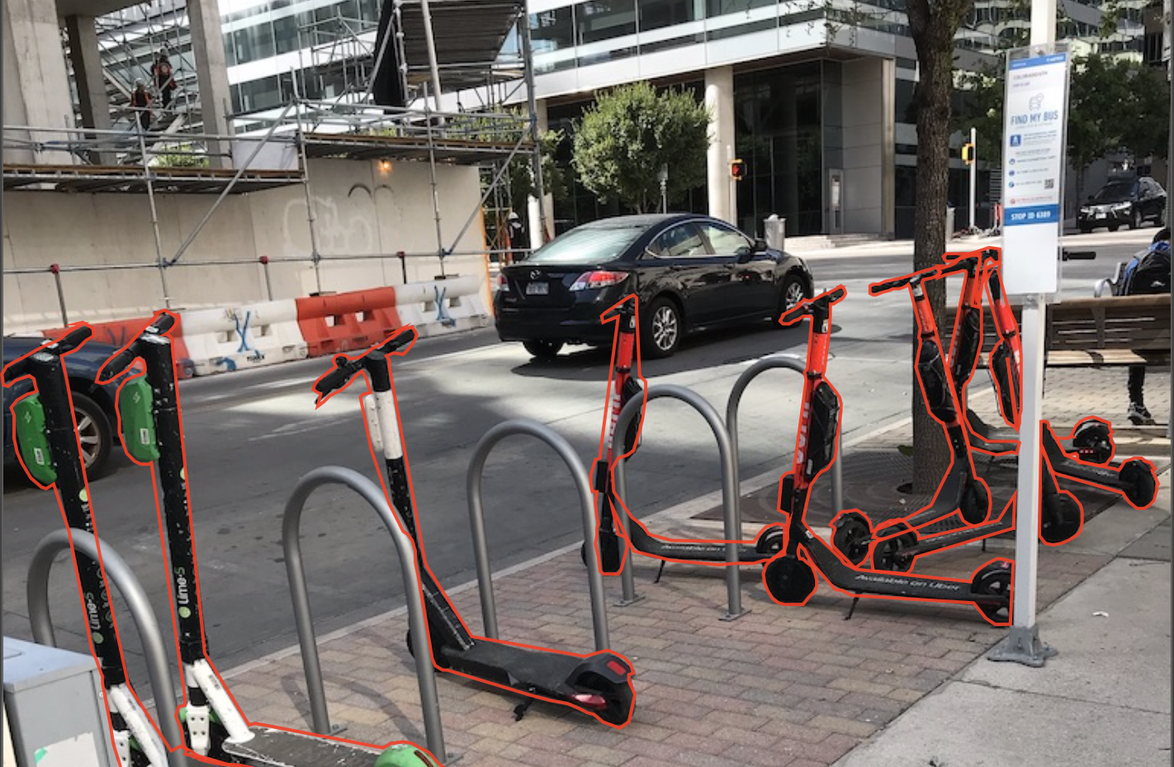

Slide 11
results

Slide 12
excellent

Slide 13
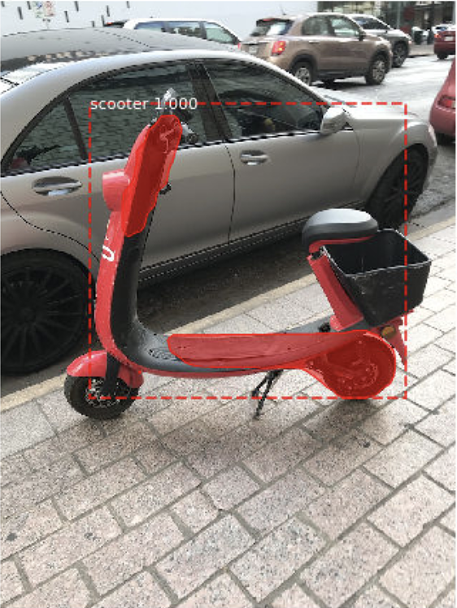
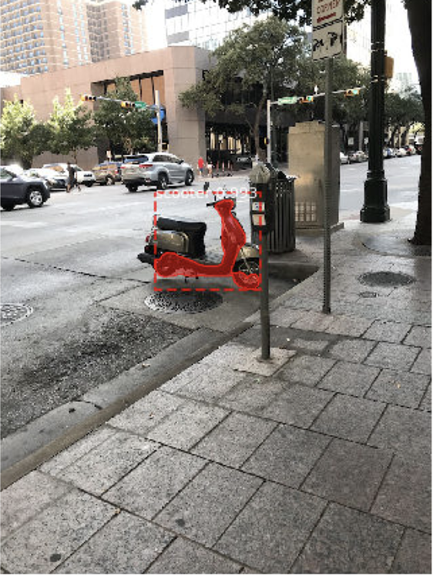
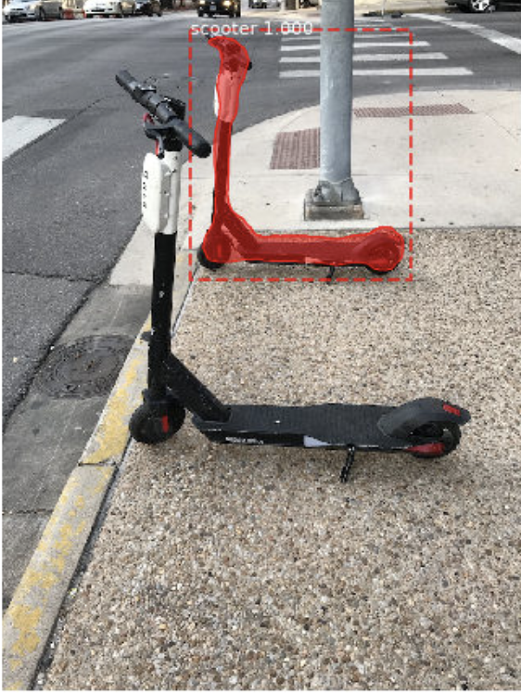
Not excellent

Slide 14
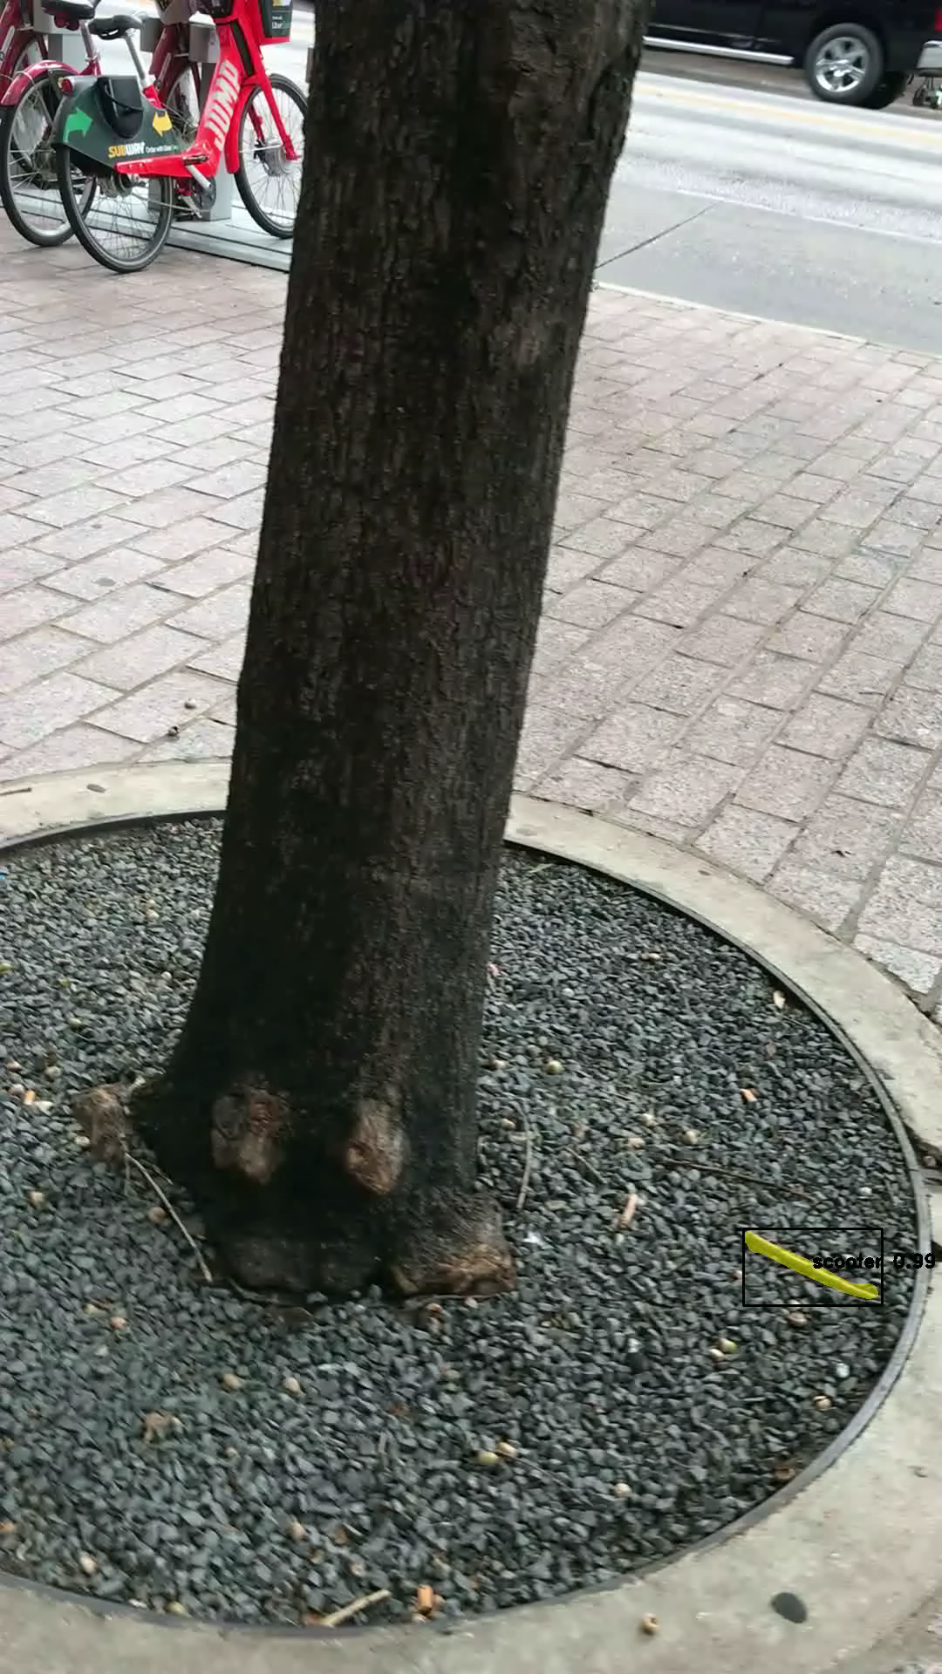

Slide 15
Transfer learning

Slide 16
Skynet is watching you

